Slide 1

Enhancing Search Engine
Relevance for Video Subtitles
Team ID : T211028
Madhavi Nalluri
Nikita Bagde

Slide 2
Background :
Scenario : In the fast-evolving landscape of digital content, effective search engines play a pivotal role in connecting users with relevant information. Imagine the frustration of searching for a specific scene in a movie and not finding it. That’s the challenge we're tackling head-on.
Example : You're trying to find a specific scene from a movie or a series, but all you get are irrelevant results.
Insight : We believe that effective search engines are the bridge between users and valuable content in today's digital world.
Objective :
We determine to develop an advanced search engine algorithm that efficiently retrieves subtitles based on user queries, with a specific emphasis on subtitle content. The primary goal is to leverage natural language processing and machine learning techniques to enhance the relevance and accuracy of search results.

Slide 3
Keyword based vs Semantic Search Engines :
Keyword Based Search Engine: These search engines rely heavily on exact keyword matches between the user query and the indexed documents.
Semantic Search Engines: Semantic search engines go beyond simple keyword matching to understand the meaning and context of user queries and documents.
Comparison: While keyword-based search engines focus primarily on matching exact keywords in documents, semantic-based search engines aim to understand the deeper meaning and context of user queries to deliver more relevant and meaningful search results.

Slide 4
🔍 Core Logic :
Our process involves meticulous data preprocessing, vectorization, and cosine similarity calculations to ensure precise search results tailored to each user's needs.
💡 Step by Step Process:
- Document Ingestion: Decoding, cleaning, chunking and generate embeddings through chunks from the subtitle data. And, store them into Chroma database.
- Document Retrieval: Creating query embeddings and calculating cosine similarity scores.

Slide 5
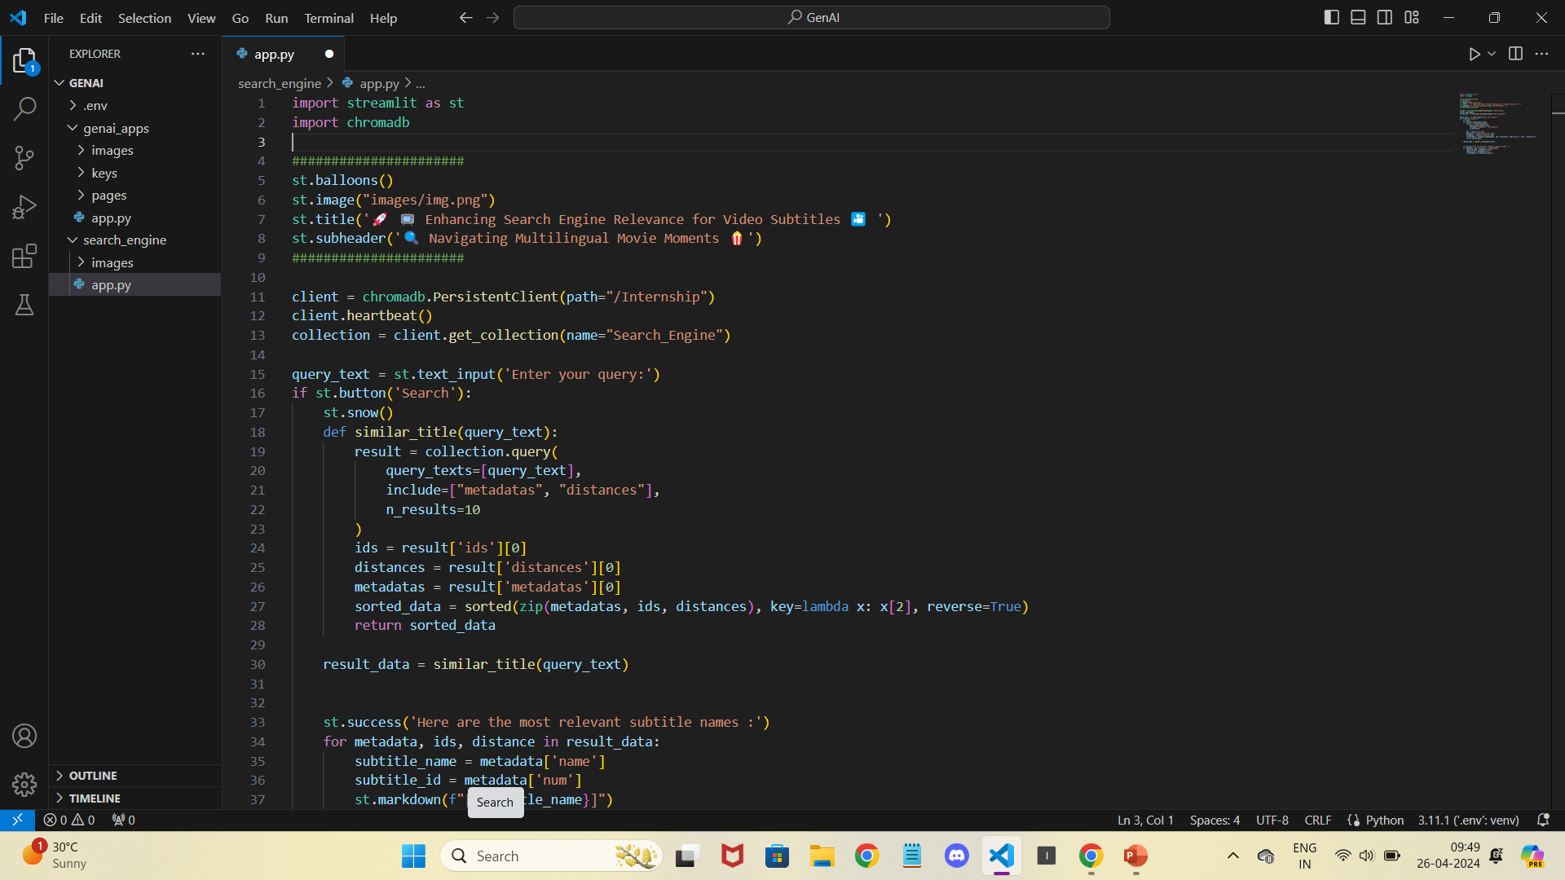
Code :

Slide 6
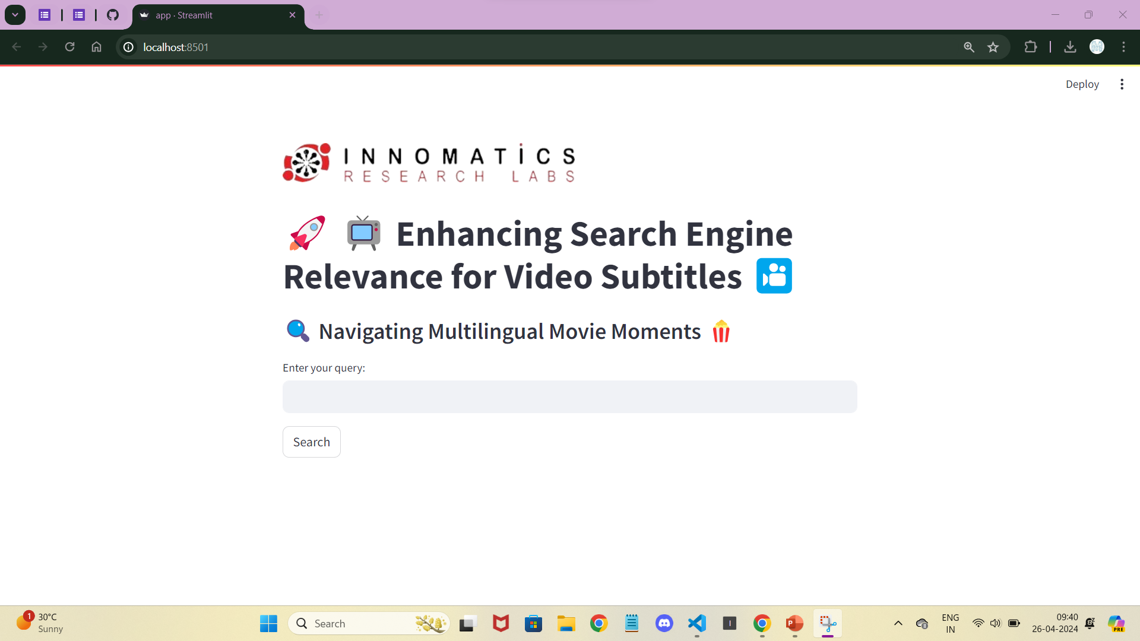
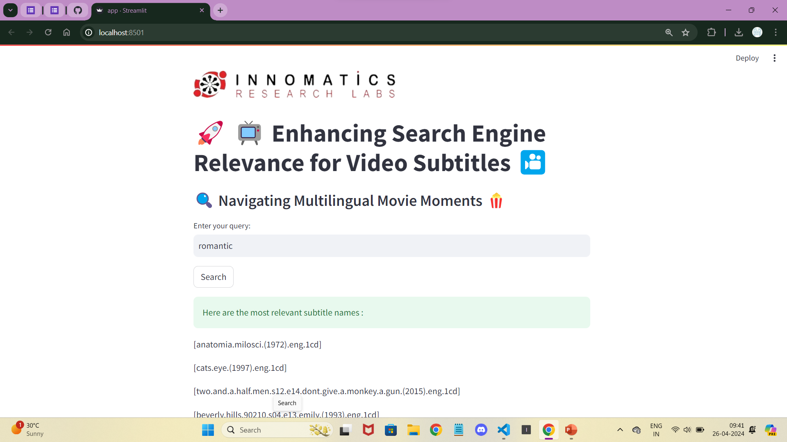
Search Engine Overview :
Search Result :

Slide 7


Thank
You

